Slide 1

presented by:-
Name of student: Annu Singh
Registration number: 12203463

Slide 2
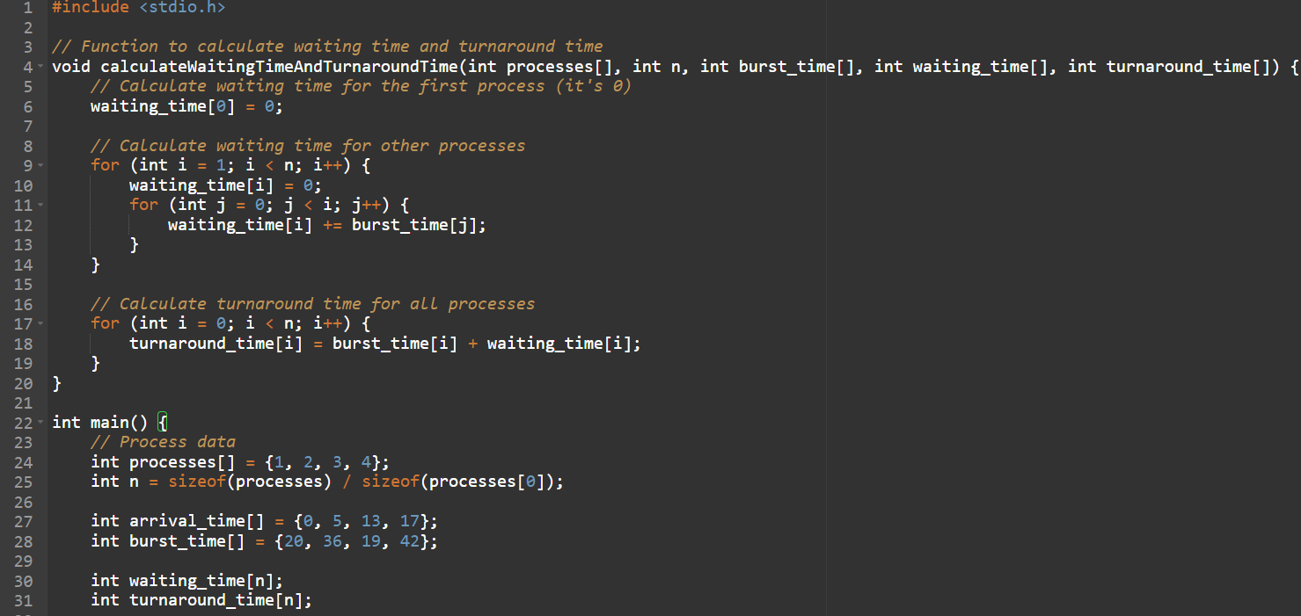
Ques. Consider a scheduling approach which is non pre-emptive similar to shortest job next in nature. The
priority of each job is dependent on its estimated run time, and also the amount of time it has spent waiting.
Jobs gain higher priority the longer they wait, which prevents indefinite postponement.
The jobs that have spent a long time waiting compete against those estimated to have short run times.
The priority can be computed as :Priority = 1+ Waiting time / Estimated run timeUsing the data given
below compute the waiting time and turnaround time for each process and average waiting
time and average turnaround time.
Process | Arrival time | Burst time
P₁ | 0 | 20
P₂ | 5 | 36
P₃ | 13 | 19
P₄ | 17 | 42

Slide 3
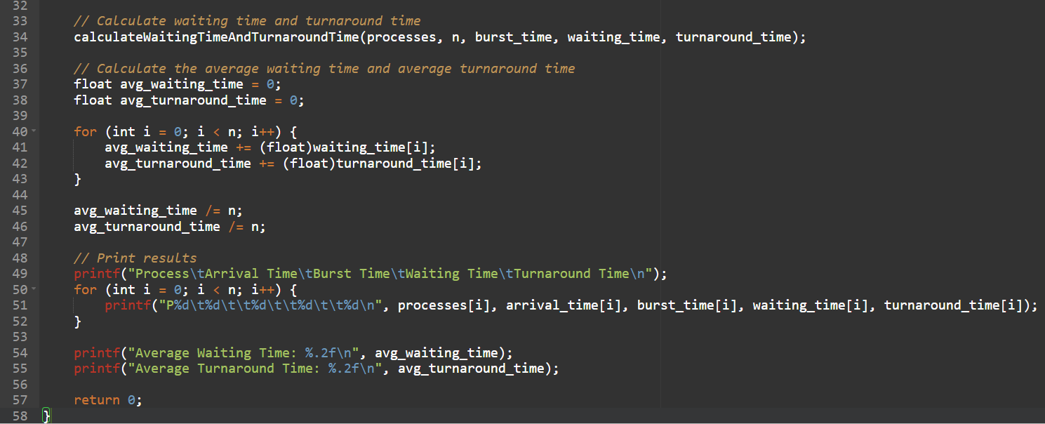
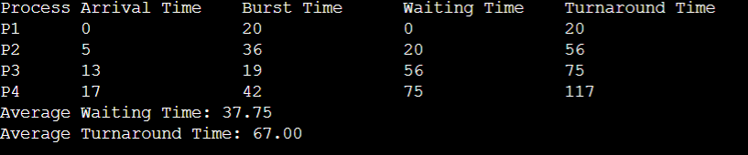
The output of the provided C program. Here's the expected output:

